Slide 1



Employee Data Analysis Using Excel
Name: S. HARINI
User ID – autunm110312201337
D9CEB63252E46EF92D44B53C3C3258B8
Department : III B. Com (General)- C
College : DRBCCC Hindu College, Pattabiram

Slide 2

Project Title
Employee Type Analysis Using Excel &
Employee Department Count Analysis Using Excel

Slide 3

AGENDA
Problem Statement
Project Overview
End Users
Our Solution & Preposition
Dataset Description
Modelling Approach
Results & Discussion
Conclusion

Slide 4

Problem Statement
* In today's dynamic business environment, organizations employ a diverse workforce, including permanent, fixed-term, and temporary employees. This variety offers flexibility but also introduces complexities in workforce management, resource allocation, and compliance with labor laws.
* The primary challenge is to analyze and categorize employees based on their employment type—permanent, fixed-term, or temporary. Understanding these categories is crucial for optimizing HR policies and aligning workforce strategies with business goals

Slide 5


Project Overview
* This project involved analyzing the organization's workforce, focusing on categorizing employees by type—permanent, fixed-term, and temporary—and assessing their distribution across departments. The analysis aimed to understand how these employment types impact departmental performance and overall productivity. Key findings revealed that a balanced mix of employee types leads to better adaptability and efficiency, while imbalances can create challenges in workload management and continuity. The project concluded with recommendations to optimize workforce composition and align it with departmental needs and organizational goals.

Slide 6

Who are the End Users?
* Human Resources (HR) Team: They will use the analysis to make informed decisions about hiring, workforce planning, and contract management.
* Department Managers: They will benefit from insights into workforce composition and its impact
on departmental performance, helping them allocate resources more effectively.
* Senior Management/Executives: They will use the findings to align workforce strategies with overall business goals and improve operational efficiency.

Slide 7
Who are the End Users?
* Senior Management/Executives: They will use the findings to align workforce strategies with overall business goals and improve operational efficiency.
* Employees: Improved workforce management can lead to better job satisfaction, as resources are allocated more effectively, and workloads are balanced.
* HR and Management Teams: They benefit from having data-driven insights that guide strategic decisions and improve departmental performance

Slide 8

Our Solution & Value Preposition
In this project, Excel was used to analyze employee types (permanent, fixed-term, and temporary) across departments.
Key techniques included:
Conditional Formatting: Applied color codes to quickly identify employee types and spot trends.
Filters: Used to isolate specific data sets, such as viewing employees by type or department.
Formulas: Employed formulas like COUNTIF and SUMIF to calculate metrics such as employee distribution and tenure.
Graphs and Charts: Created visual representations like pie charts and bar graphs to clearly display the data and highlight key insights.

Slide 9
Dataset Description
For this project, the dataset was sourced from the IBM Skills Build Dashboard, containing 20 features. The analysis focused on key features:
User ID: Unique employee identifier.
Name: Employee’s full name.
Gender: Employee gender, for diversity analysis.
Employee Type: Employment contract type (permanent, fixed-term, temporary).
Employee Department: Department assignment.
Using Excel, formulas were applied to analyze employee types and department distribution. Conditional formatting and visualizations (graphs and charts) were used to identify patterns and trends, providing insights for workforce planning.

Slide 10

Modelling Approach
1. Data Acquisition:
Downloaded a dataset from the IBM Skills Build Dashboard, which included features like User ID, Name, Gender, Employee Type, and Department.
2. Data Preparation:
Imported the dataset into Excel.
Cleaned the data to correct any inconsistencies or errors.
3. Initial Exploration:
Reviewed the dataset to understand its structure.
Used summary statistics to gain preliminary insights.

Slide 11
Modelling Approach
4. Feature Analysis:
Employee Type: Analyzed the distribution of employee types (Permanent, Fixed-term, Temporary) by applying filters and using Excel formulas like COUNTIF to count each type. Applied conditional formatting to visually distinguish between different employee types.
Department: Examined the distribution of employees across departments. Calculated the number of employees in each department and used conditional formatting for emphasis
5. Data Visualization:
Created visualizations to illustrate the data:
Pie Charts: Displayed the proportion of different employee types and departmental distribution.
Bar/Column Charts: Compared the number of employees by type and department.
Graphs: (If applicable) Analyzed trends over time.

Slide 12
Modelling Approach
6. Pattern Identification:
Identified patterns and trends in the data regarding employee types and departmental distribution. Highlighted any anomalies or significant findings.
7. Reporting:
Summarized key insights from the analysis.
Compiled visuals into a report, providing a clear presentation of findings and recommendations for workforce planning and departmental adjustments.

Slide 13
Modelling Approach
8. Review and Presentation:
Ensured accuracy and clarity in the analysis and visualizations.
Prepared and presented the final report to stakeholders, including recommendations based on the data.

Slide 14
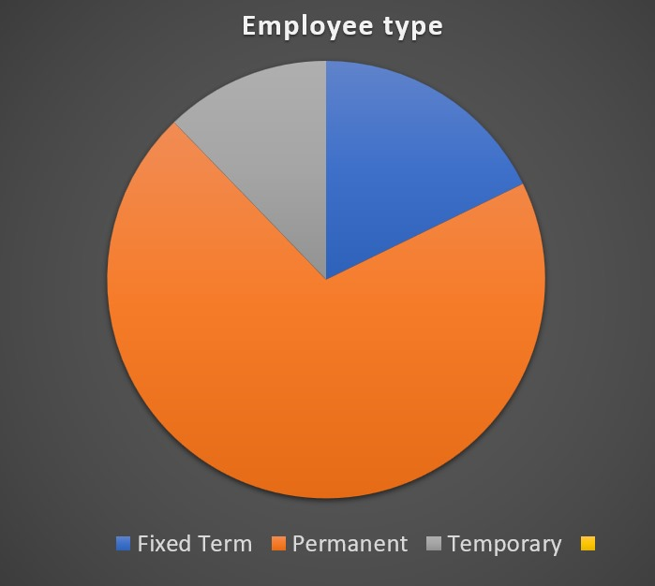
PIE CHART

Slide 15
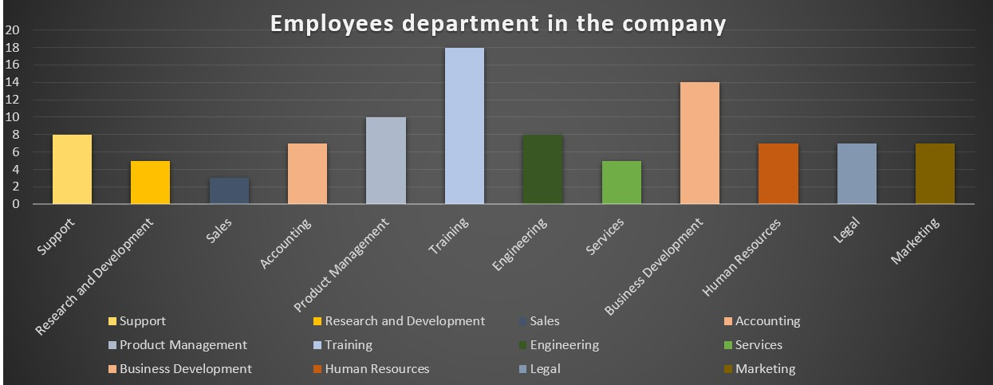

Slide 16
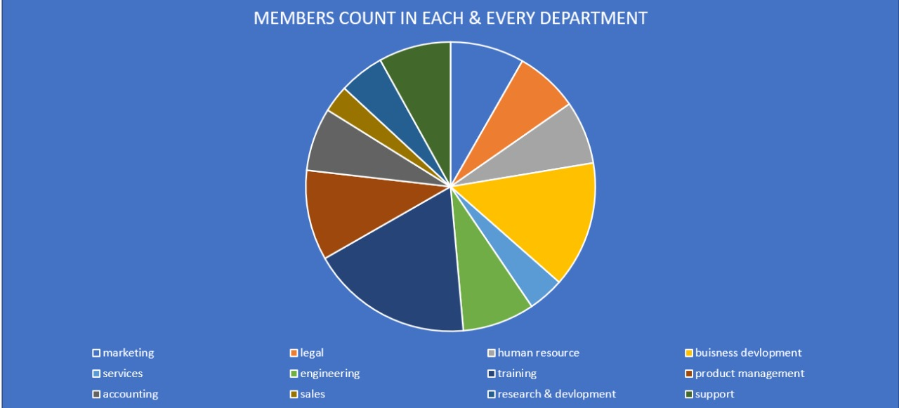

Slide 17

Conclusion
Conclusion:
The analysis revealed the distribution of employee types (Permanent, Fixed-term, Temporary) and departmental staffing levels. Key insights included trends such as increased fixed-term contracts and notable anomalies in staffing patterns. Recommendations include balancing staffing levels and revising employment policies to address these issues. The findings highlight areas for potential improvement in workforce management. The results have implications for organizational efficiency and performance, with suggested next steps involving further analysis and action planning. Key charts and graphs were used to visually support these conclusions and facilitate decision-making.

